Slide 1
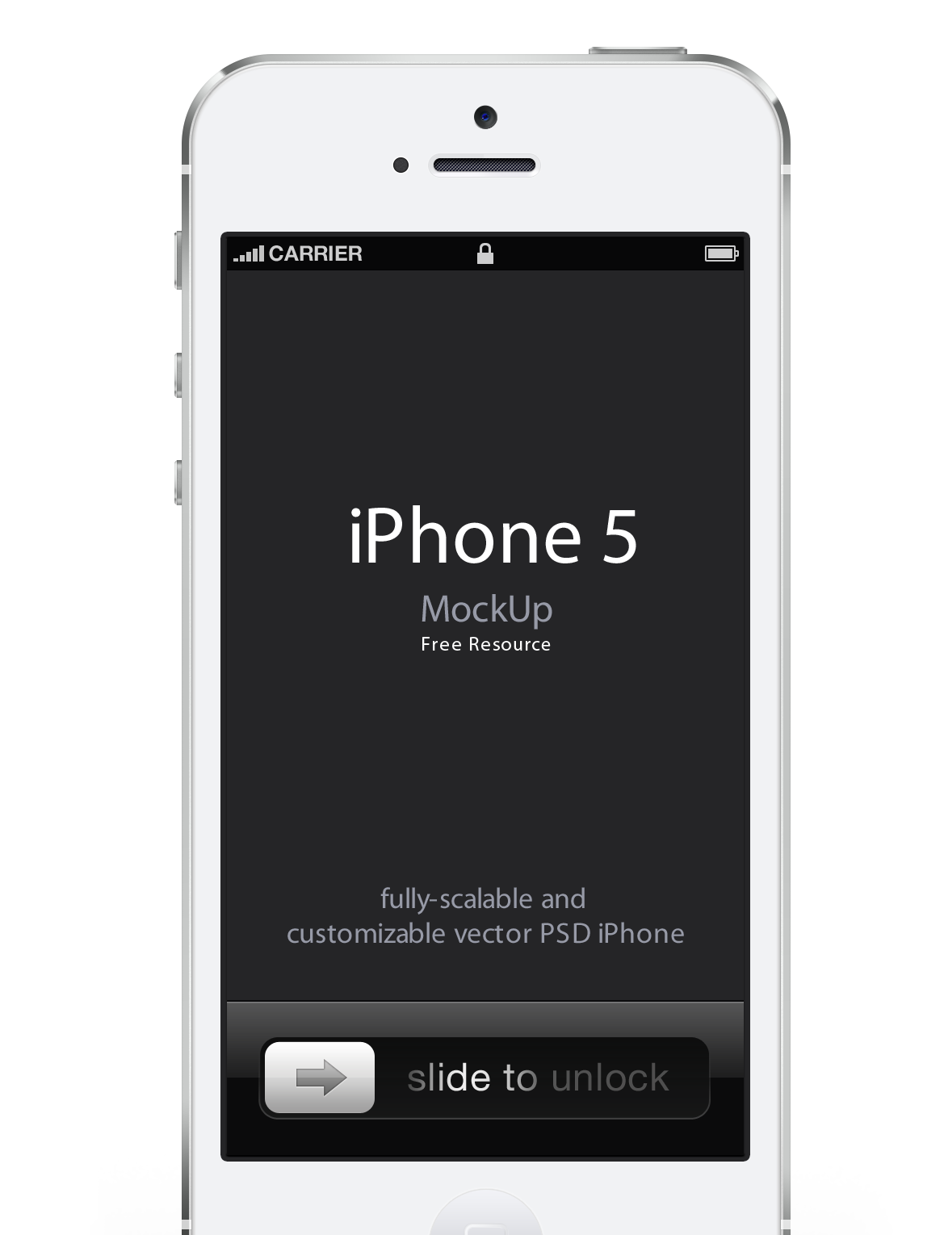



Data Science Class (DAT4) – Final Project

Slide 2
What do we do:
Feedback & Response Platform:
Brands
Broadcasters
Publishers
k-12, higher-ed
Government
non-Profits

Slide 3
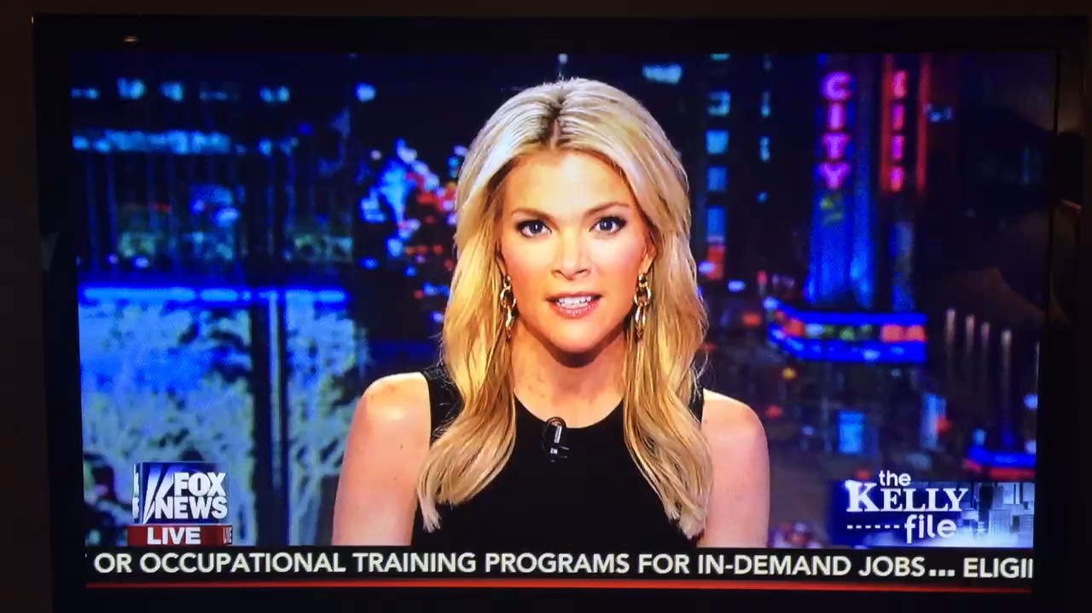
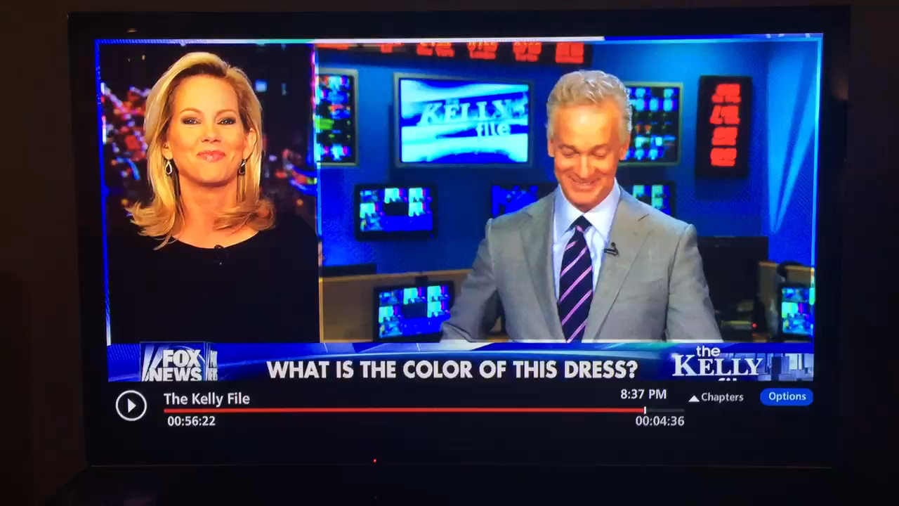
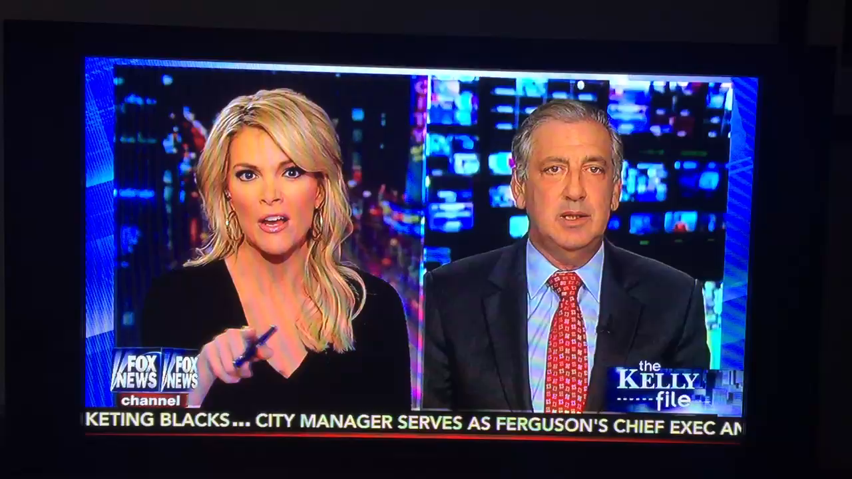

Slide 4
We collect a lot of data…

Slide 5
The Problem:
We don’t present the content in an organized (or particularly useful) way…

Slide 6
The Hypothesis:
It is highly likely that over time, with the creation of many questions (polls and brainstorms), NATURAL categories have emerged.

Slide 7
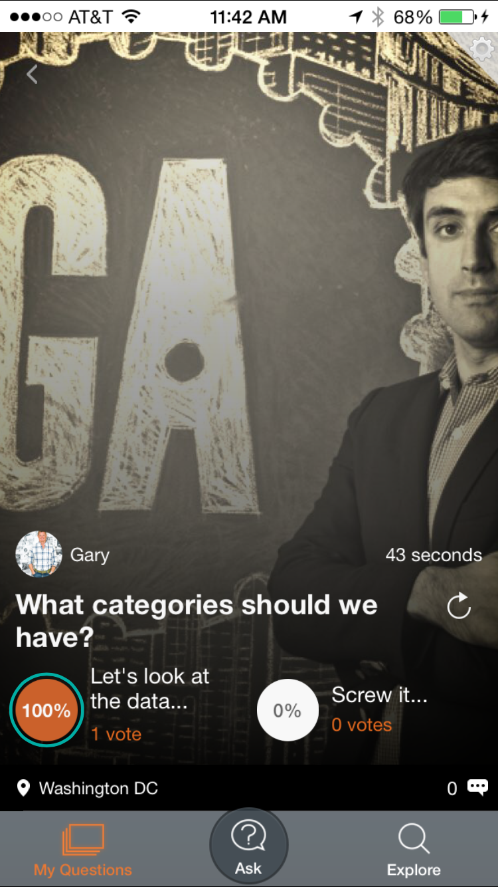
The Question/Challenge/Need:
What are the natural content 'Categories' that have been created via app usage?

Slide 8
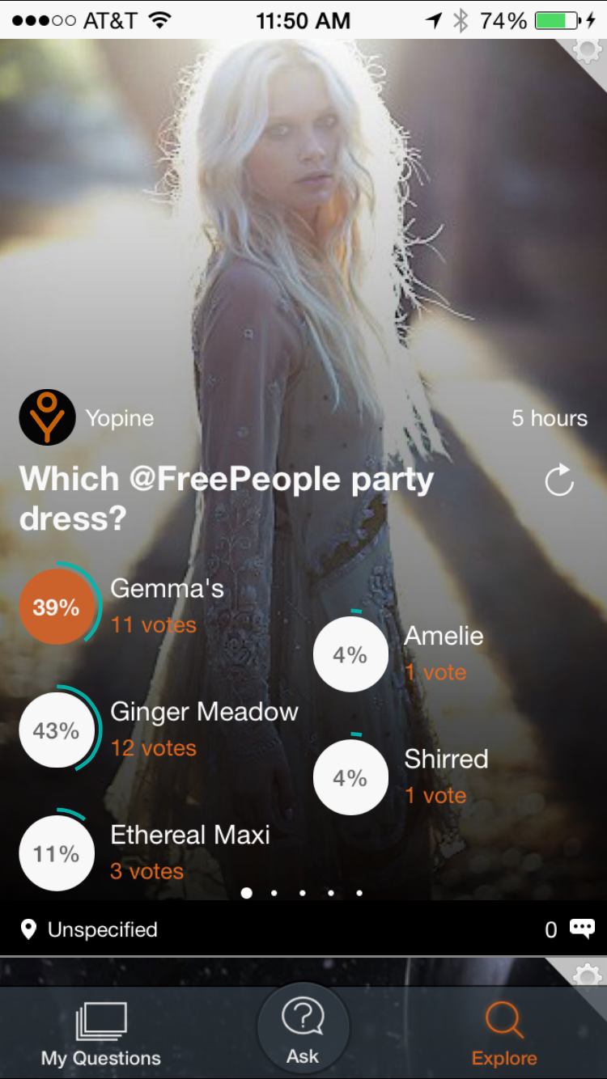
Why:
All content is presented in ‘Explore’ view today simply chronologically.

Slide 9
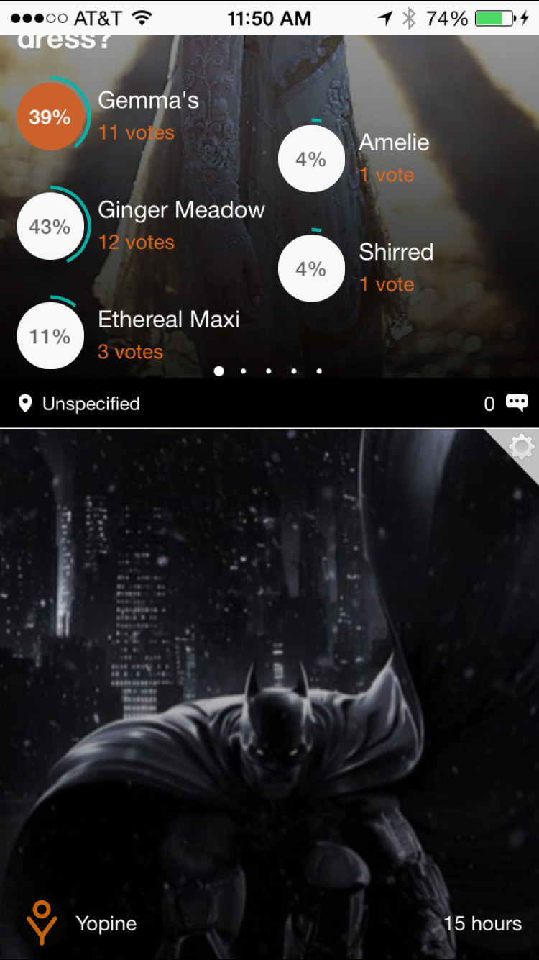
Why:
All content is presented in ‘Explore’ view today simply chronologically.

Slide 10
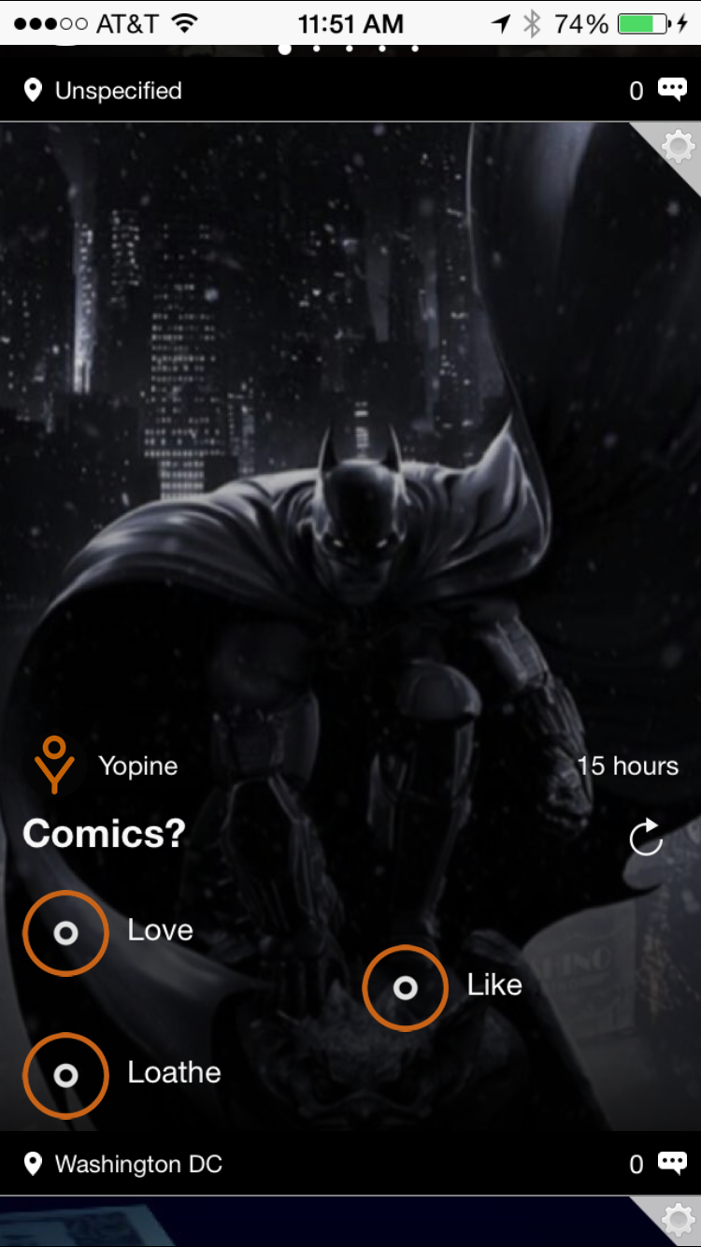
Why:
All content is presented in ‘Explore’ view today simply chronologically.
There is nothing that keeps a fashion oriented poll separated from a comic book poll…

Slide 11
Why:
You can bet those are two very different people/demographics...
Users shouldn’t have to sift through content that is of no interest to them.

Slide 12
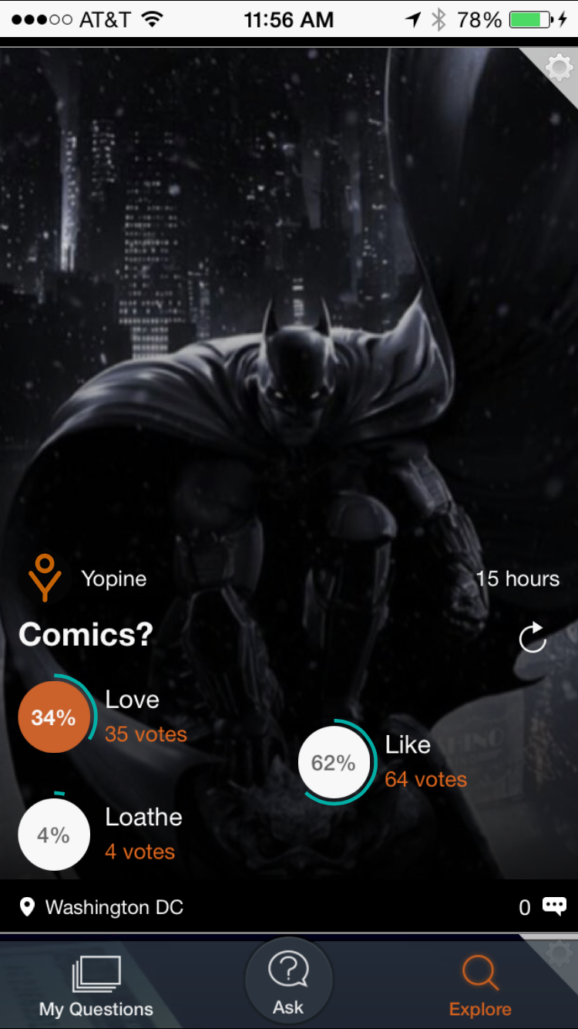
Data:
Everything we need to know is contained in the questions and the responses.

Slide 13
Data:
Everything we need to know is contained in the questions and the responses.
We will let Machine Learning do the work to dictate how our content should be organized.

Slide 14
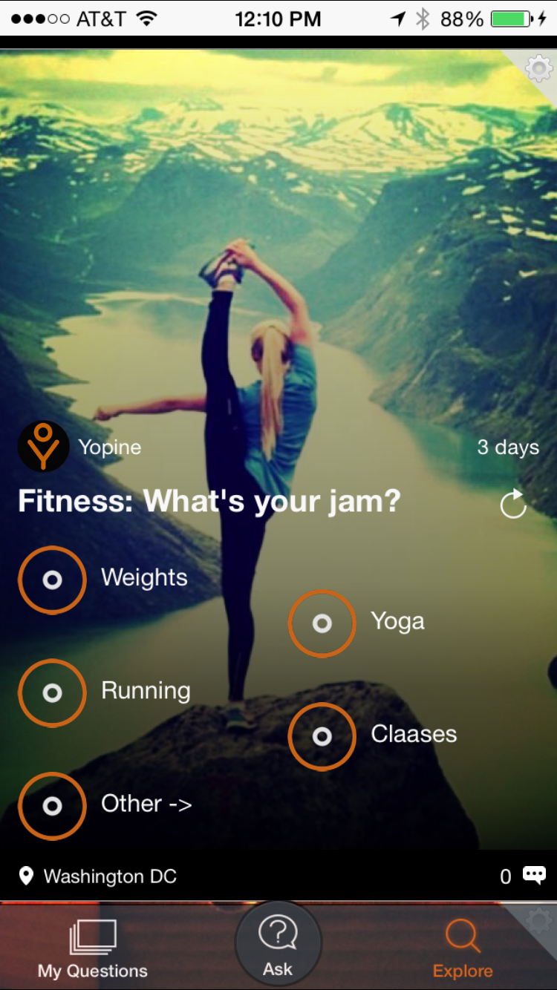
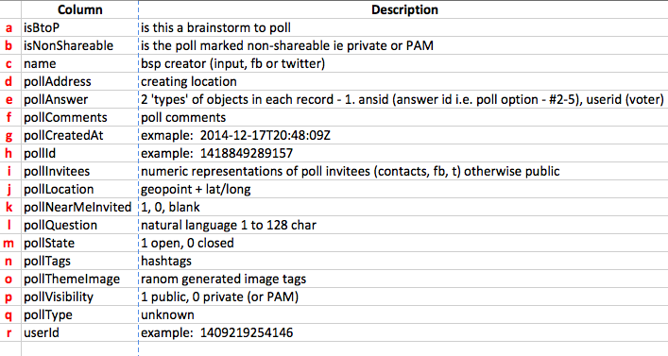
the Data:
first, the metadata -

Slide 15
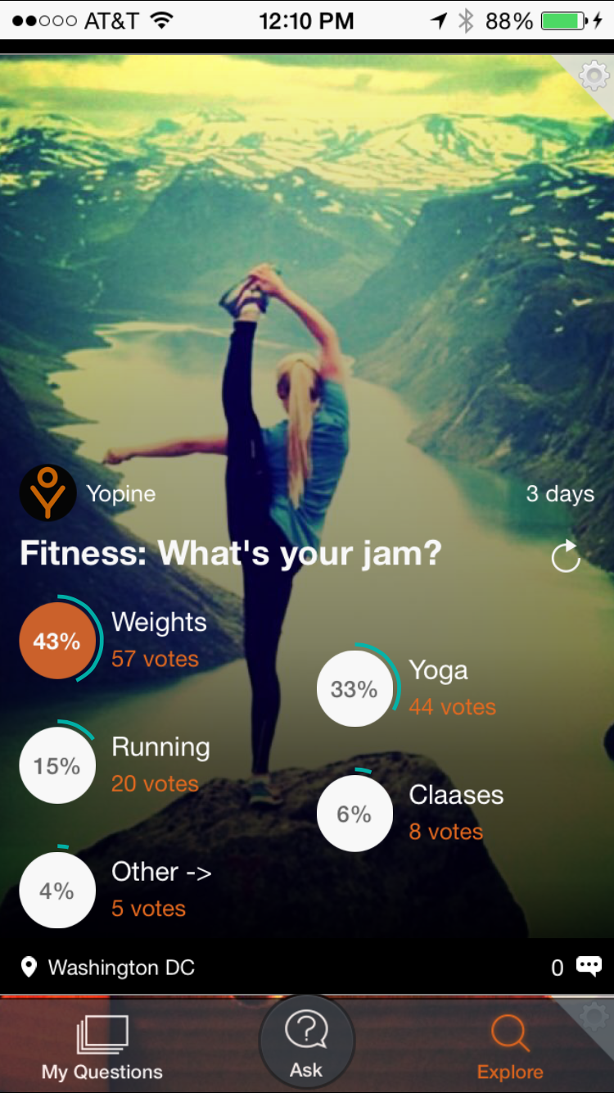
the Data:
first, the metadata -
2 columns matter – pollQuestion (#12) & pollAnswer (#5)

Slide 16
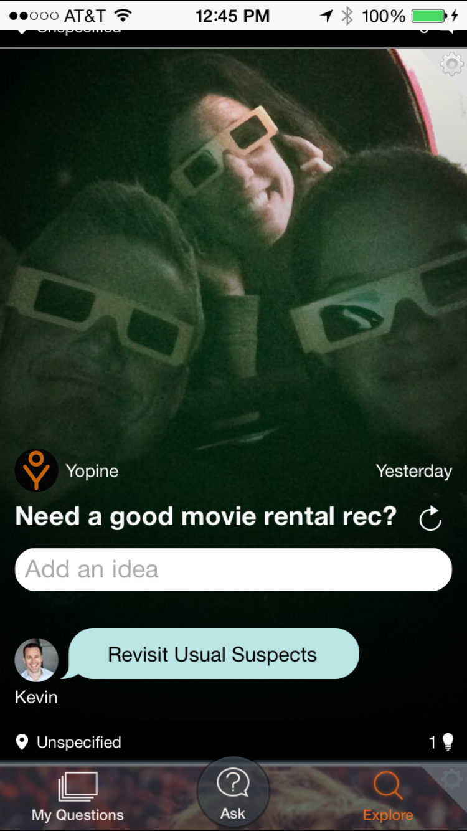
the Data:
first, the metadata -
2 columns matter – pollQuestion (#12) & pollAnswer (#5)

Slide 17
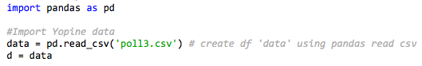
the Data:

Slide 18
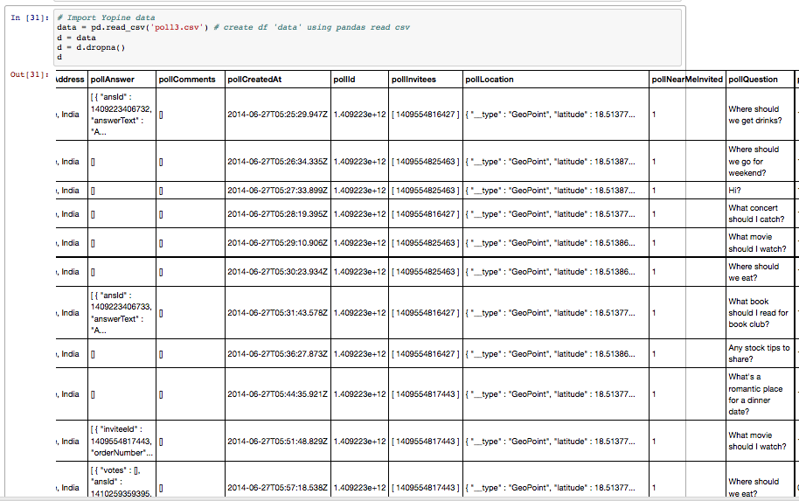
the Data:

Slide 19
The Plan (the data science):
TFIDF (Term Frequency Inverse Document Frequency) + LDA – to create topics
Fit a predictive model for future polls
Why:
Need to group similar data into sets(topics)
Need to discover topics from human sentences(NLP)

Slide 20
My hope is that the data will reflect what I believe (through 2.5 years of cursory observation) to be the correct categories.

Slide 21
My hope is that the data will reflect what I believe (through 2.5 years of cursory observation) to be the correct categories.
Whatever the data reveals will be what goes into the product.

Slide 22
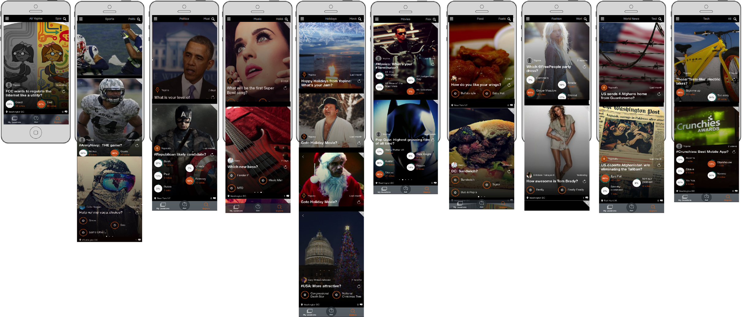
Best Guess @ Categories:
Sports
Politics
Music
Holidays
Movies
Food
Fashion
World
Tech
Something like this…

Slide 23
Something like this…

Slide 24
Something like this…

Slide 25
More insane CODE:

Slide 26
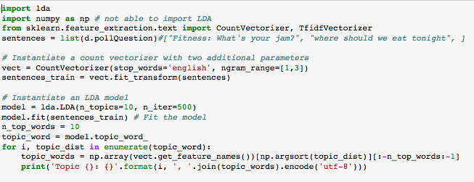
More insane CODE:

Slide 27
the CODE:
CountVectorizer supports counts of N-grams of words or consecutive characters.
Once fitted, the vectorizer has built a dictionary of feature indices:
They are the TOPICS…

Slide 28
the Results:
Topic 0: catch, concert catch, concert, think, job, deals, florida st, florida, surf shop deals
Topic 1: book, read, book read, san, best breakfast, san diego, breakfast, vote, bad
Topic 2: favorite, beer, wifi, iphone, abcd, want, pam speeding train, want hear, train wifi
Topic 3: test, poll, pam, ios, pam test, poll test, test boat, jeff, house
Topic 4: testing, pam, testing pam, pam swa, pam swa 486, 486, swa, testing pam swa, swa 486
Topic 5: near, drinks, hi, test2, mozilla, stock, gimbal, weekend, fh
Topic 6: watch, place, good, tv, tv watch, date, romantic place, dinner date, movie watch
Topic 7: summer, summer 2014, 2014, burger, polls, sf, 10, series massages, shades
Topic 8: best, water, eat, restaurant, dc, overwhelmingly, terrorists, test boat lot, galaxy
Topic 9: tonight, eat, gary, train, life, going, sandjammwwnj, wins, nfc wins today

Slide 29
the Results: MUSIC
Topic 0: catch, concert catch, concert, think, job, deals, florida st, florida, surf shop deals
Topic 1: book, read, book read, san, best breakfast, san diego, breakfast, vote, bad
Topic 2: favorite, beer, wifi, iphone, abcd, want, pam speeding train, want hear, train wifi
Topic 3: test, poll, pam, ios, pam test, poll test, test boat, jeff, house
Topic 4: testing, pam, testing pam, pam swa, pam swa 486, 486, swa, testing pam swa, swa 486
Topic 5: near, drinks, hi, test2, blues, stock, gimbal, weekend, fh
Topic 6: watch, place, good, tv, tv watch, date, romantic place, dinner date, movie watch
Topic 7: summer, summer 2014, 2014, burger, polls, sf, 10, series massages, shades
Topic 8: Pandora, water, eat, restaurant, dc, overwhelmingly, terrorists, test boat lot, galaxy
Topic 9: tonight, eat, gary, train, life, going, sandjammwwnj, wins, nfc wins today

Slide 30
the Results: TECH
Topic 0: catch, concert catch, concert, think, job, deals, florida st, florida, surf shop deals
Topic 1: book, read, book read, san, best breakfast, san diego, breakfast, vote, bad
Topic 2: favorite, beer, wifi, iphone, abcd, want, pam speeding train, want hear, train wifi
Topic 3: test, poll, pam, ios, pam test, poll test, test boat, jeff, house
Topic 4: testing, pam, testing pam, pam swa, pam swa 486, 486, swa, testing pam swa, swa 486
Topic 5: near, drinks, hi, test2, blues, stock, gimbal, weekend, fh
Topic 6: watch, place, good, tv, tv watch, date, romantic place, dinner date, movie watch
Topic 7: summer, summer 2014, 2014, burger, polls, sf, 10, series massages, shades
Topic 8: Pandora, water, eat, restaurant, dc, overwhelmingly, terrorists, test boat lot, galaxy
Topic 9: tonight, eat, gary, train, life, going, sandjammwwnj, wins, nfc wins today

Slide 31
the Results: AWESOME DUDES
Topic 0: catch, concert catch, concert, think, job, deals, florida st, florida, surf shop deals
Topic 1: book, read, book read, san, best breakfast, san diego, breakfast, vote, bad
Topic 2: favorite, beer, wifi, iphone, abcd, want, pam speeding train, want hear, train wifi
Topic 3: test, poll, pam, ios, pam test, poll test, test boat, jeff, house
Topic 4: testing, pam, testing pam, pam swa, pam swa 486, 486, swa, testing pam swa, swa 486
Topic 5: near, drinks, hi, test2, blues, stock, gimbal, weekend, fh
Topic 6: watch, place, good, tv, tv watch, date, romantic place, dinner date, movie watch
Topic 7: summer, summer 2014, 2014, burger, polls, sf, 10, series massages, shades
Topic 8: Pandora, water, eat, restaurant, dc, overwhelmingly, terrorists, test boat lot, galaxy
Topic 9: tonight, eat, GARY, train, life, going, sandjammwwnj, wins, nfc wins today

Slide 32
Actual Roadmap Categories:
Music
Tech
Awesome Dudes
Xxx
Yyy
Zzz

Slide 33
Challenges:
Data – easy (1 table, 2 columns)
Cleaning it – pretty easy…clean
Deciding on models – tho I sorta knew from the first class after seeing the NPR One project
Code – I thought this class was being done in COBOL.

Slide 34
Successes:
Seeing my baby all growed up and from a purely scientific perspective revealing product direction and roadmap (nobody can really blame me for some whacky category like ‘weather’.
Having the tools in place to finish this model so that I can run it every so often and adjust the categories based on what the people are saying.

Slide 35
Next steps: refine the model to perhaps add weight to each instance of each categorized row with its associated ‘voteCount’
A few more projects using this data set:
When I get a new document (aka poll) how accurately can I automatically place it into an existing category?
What is the overall tone/sentiment of votes contributions and comments? Is the Yopine user base mostly happy and positive or angry a-holes?
Utilize our #tag data to help categorize

Slide 36
Thank you!
gary@yopine.com
@garywmendel
@YoYopine

